Slide 1



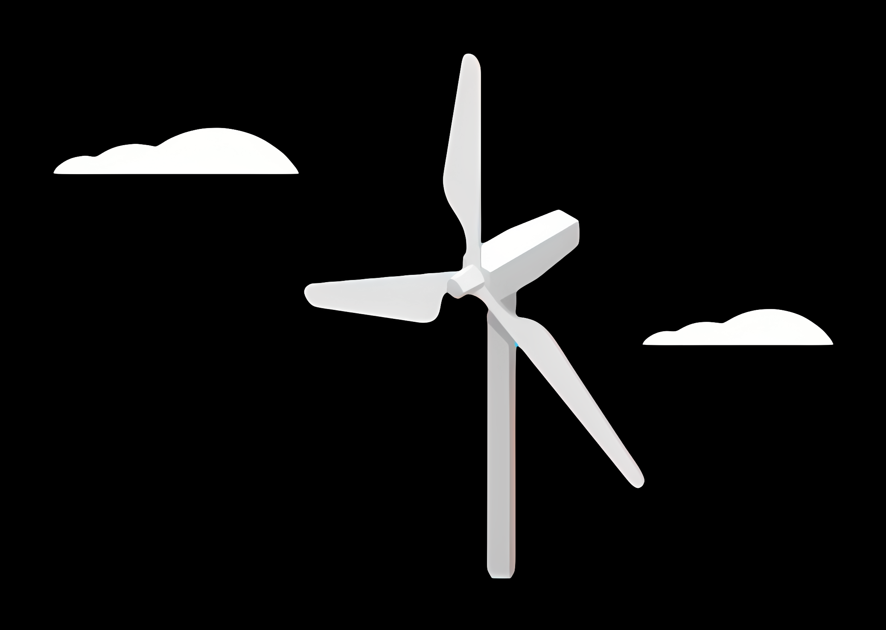
Weekly report: Load & Dynamics
Week number: 05
Date: 28/10/2025
Supervisor: Mr. Manjock
Group members: Md Aman, Arham Memon, Paresh Nakum
Presenter – Arham Memon
28/10/2025
Md Aman, Arham Memon, Paresh Nakum
Optimus Syria

Slide 2
Agenda For Loads & Dynamics
Wind Turbine Class
Turbine Configuration in OpenFAST
Wind Field Generation
OpenFAST Folder
Conclusion & Future Plan
Bibliography
28/10/2025
Arham Memon
Load & Dynamics Team/ Optimus Syria

Slide 3
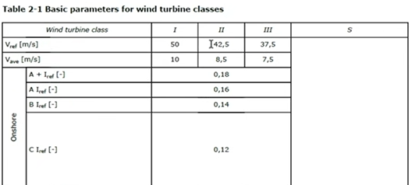
Wind Turbine Class and Extreme Wind Speeds
Since no measurements of extreme wind speeds are available for Syrian site, we have to take extreme wind speeds from standards.
Vewm1 = 0.8*Vref = 34m/s {EWM = Extreme Wind Module}
Vewm50 = 1.4*Vref = 59.5m/s
(0.8 & 1.4 are empirical multipliers derived from statistical modeling of annual and 50-year return period wind speed.)
Source: IEC 61400-1:2019/DNVGL-ST-0437:2021
28/10/2025
3
Arham Memon
Load & Dynamics Team/ Optimus Syria

Slide 4
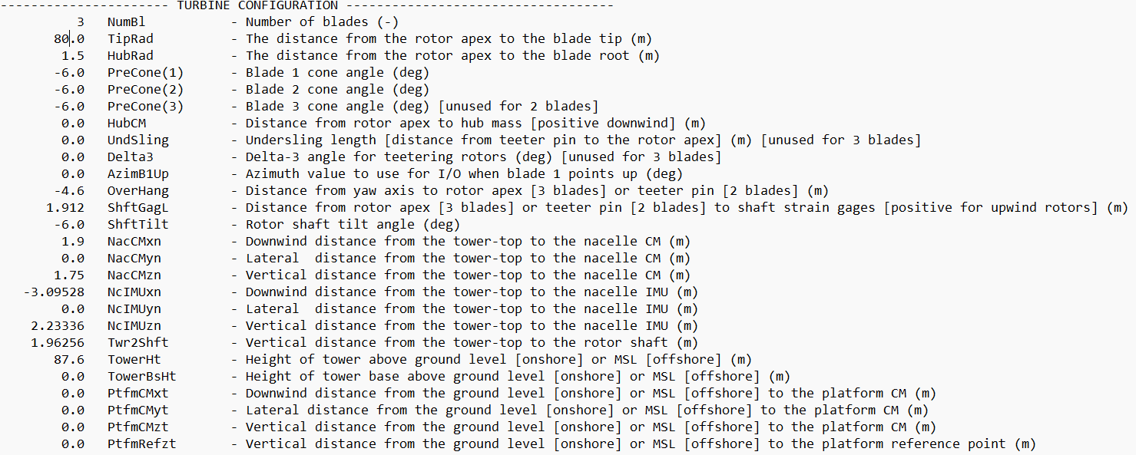
Turbine Configuration in OpenFAST
TurbSim Input File
OPTSyria5MW_ElastoDyn.dat
Note: For NTM case blade pitch is zero and for ETM & EWM its 90 degree
28/10/2025
4
Arham Memon
Load & Dynamics Team/ Optimus Syria

Slide 5
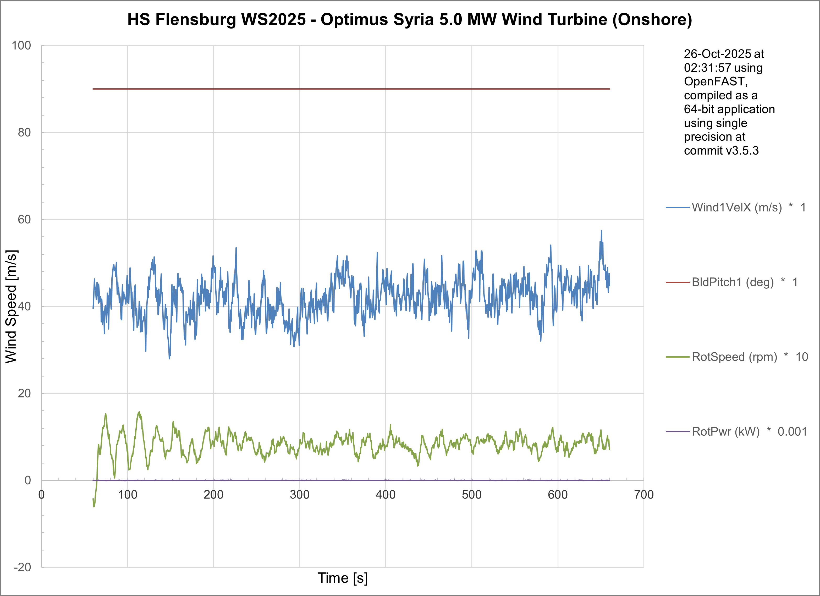
Wind Field Generation
DLC 6.1 for 2EWM50 with Vref 42.5m/s & scaling velocity VEWM = 59.5 m/s
28/10/2025
5
Arham Memon
Load & Dynamics Team/ Optimus Syria

Slide 6
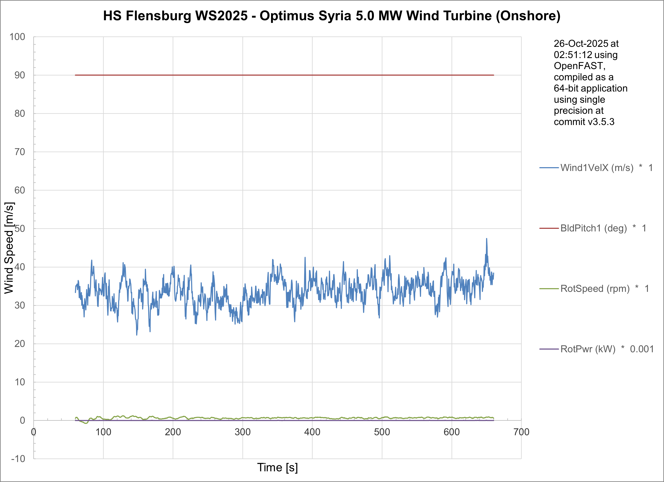
Wind Field Generation
DLC 6.1 for 2EWM1 with Vref 42.5m/s & scaling velocity VEWM = 34m/s
28/10/2025
6
Arham Memon
Load & Dynamics Team/ Optimus Syria

Slide 7
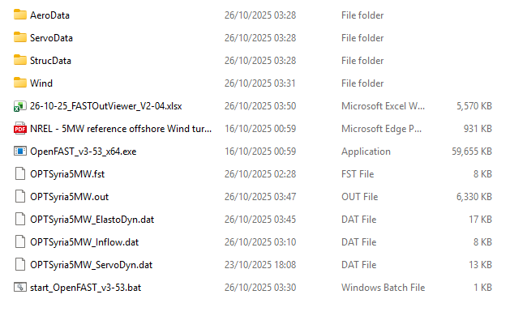
OpenFAST Folder
The updated folder for simulation in Openfast & turbsim.
28/10/2025
7
Arham Memon
Load & Dynamics Team/ Optimus Syria

Slide 8
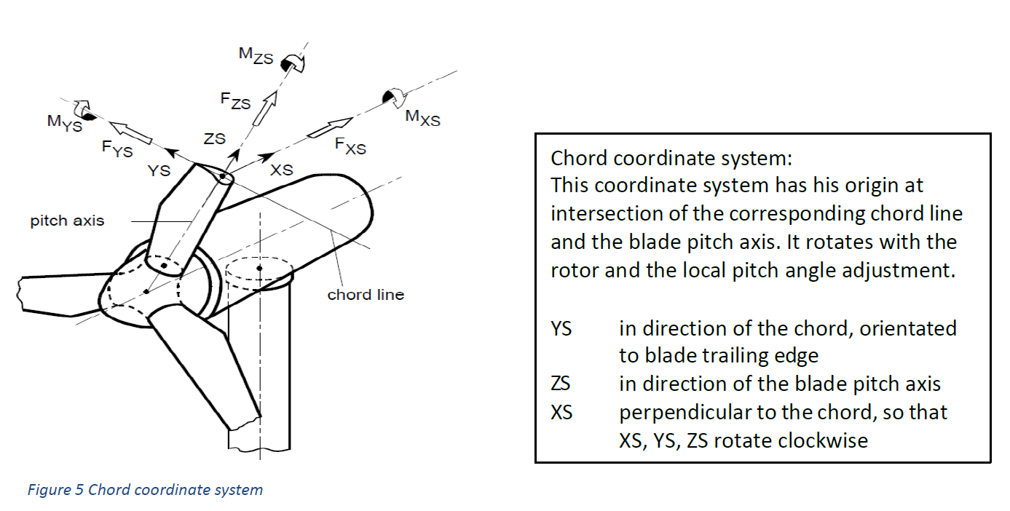
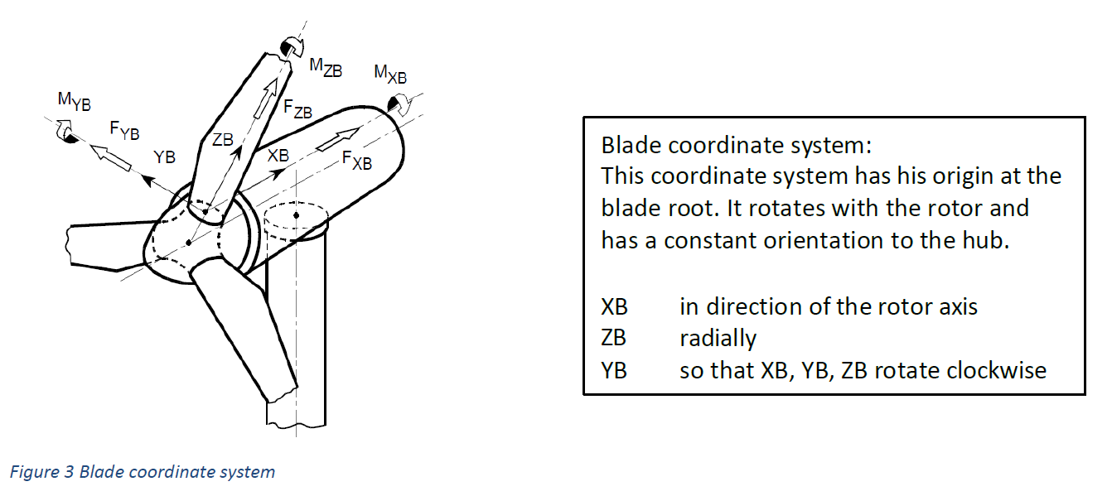
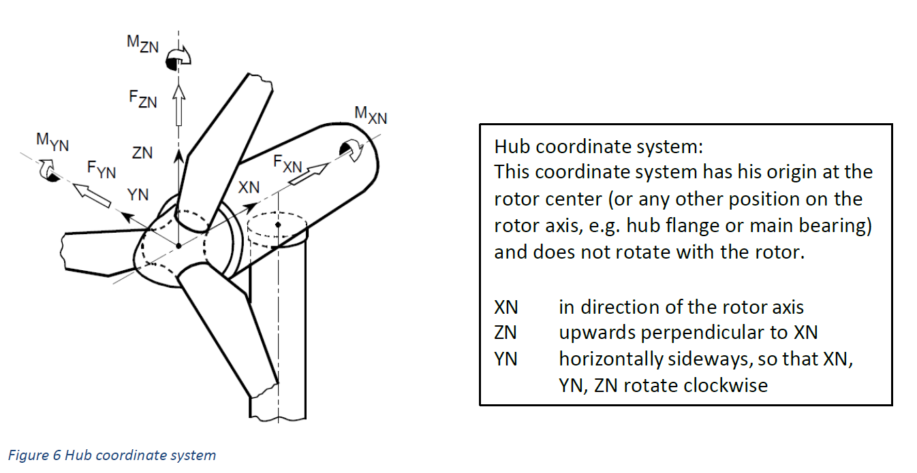
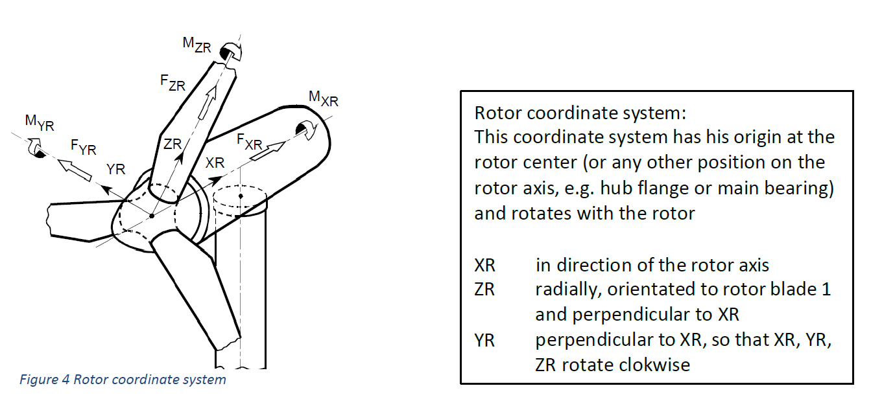
Load components for other teams
Please use GL-coordinates to specify requested load components
Source: GL Guideline 2010 / Optimus Shakti load report WS24-25
28/10/2025
Arham Memon
Load & Dynamics Team/ Optimus Syria

Slide 9
Conclusion & Future Plan
In the last week we
Configured OpenFast for Optimus Syria
Configured Wind Simulations for NTM, ETM, EWM
Configured Simulation with DLC 6.1
Provided forces and moments at different section of turbine to other teams
In the next week
We simulate OpenFAST for updated parameter of turbine
Configure Simulation with other DLC Cases
Use RK4 Integration method
Work with different groups
28/10/2025
9
Arham Memon
Load & Dynamics Team/ Optimus Syria

Slide 10
References
Load Reports of the OPTIMUS projects
GL Guideline for the Certification of Wind Turbines Edition 2010
Loads and site conditions for wind turbines, DNVGL-ST-437,Edition November 2016
IEC 61400-1 2019-02, Ed. 4.0/ DNVGL-ST-0437 Loads and site conditions for wind turbines 11-2016
TurbSim, OpenFAST & NREL 5 MW
28/10/2025
10
Arham Memon
Load & Dynamics Team/ Optimus Syria

